Slide 1
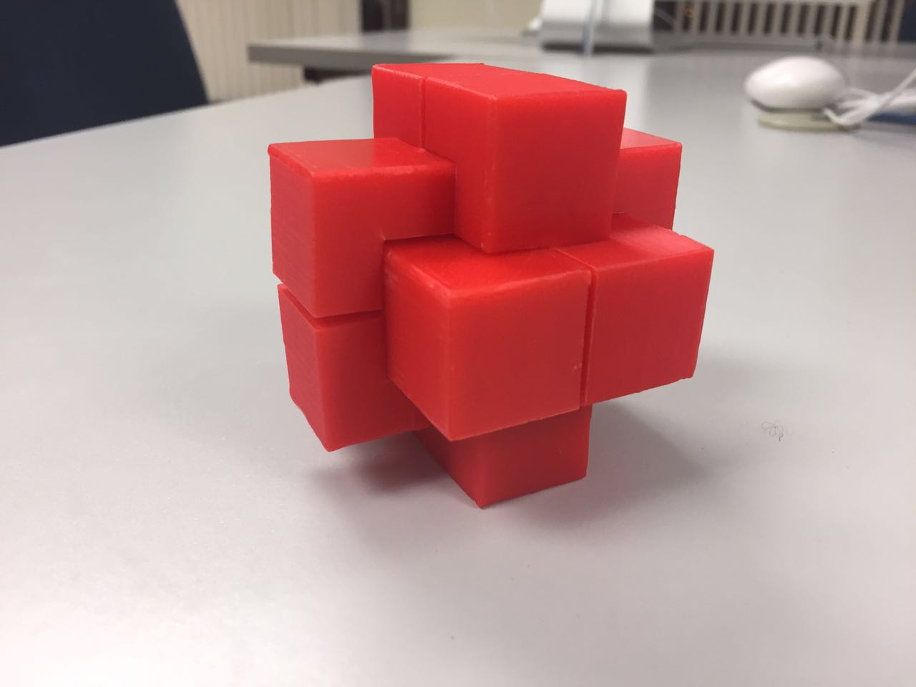
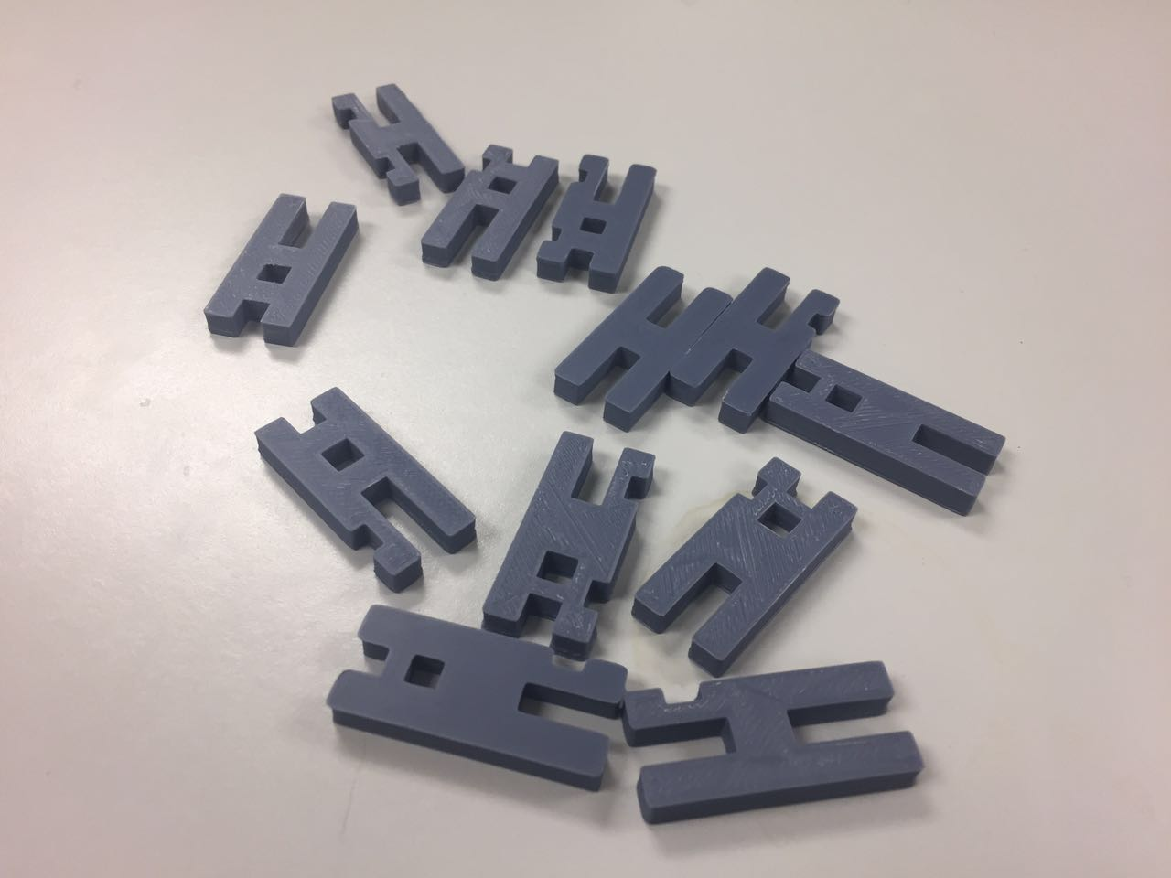
Burr Puzzle 3D Printing through Blender
Jianqiu Bai, Thomas Matlak, Yunjia Zeng

Slide 2
Introduction
3D Printing
Evaluation
Acura
Burr Puzzle
Blender
Model

Slide 3
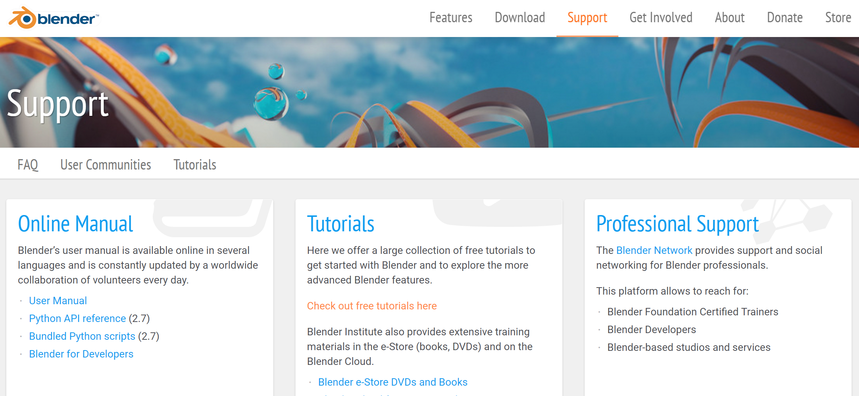
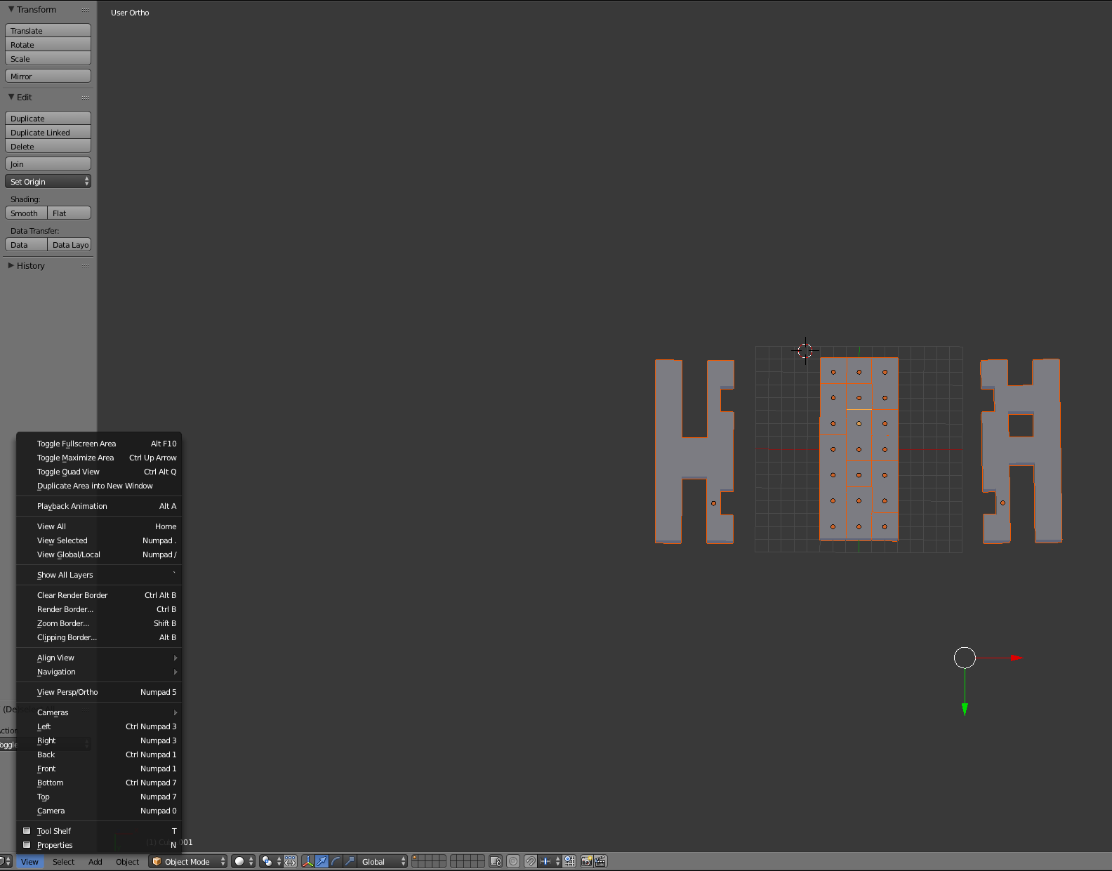
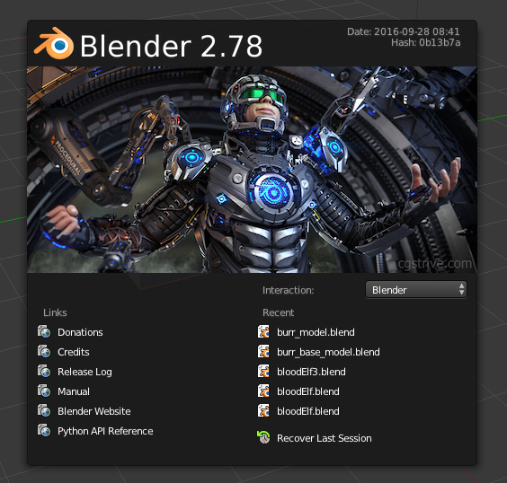
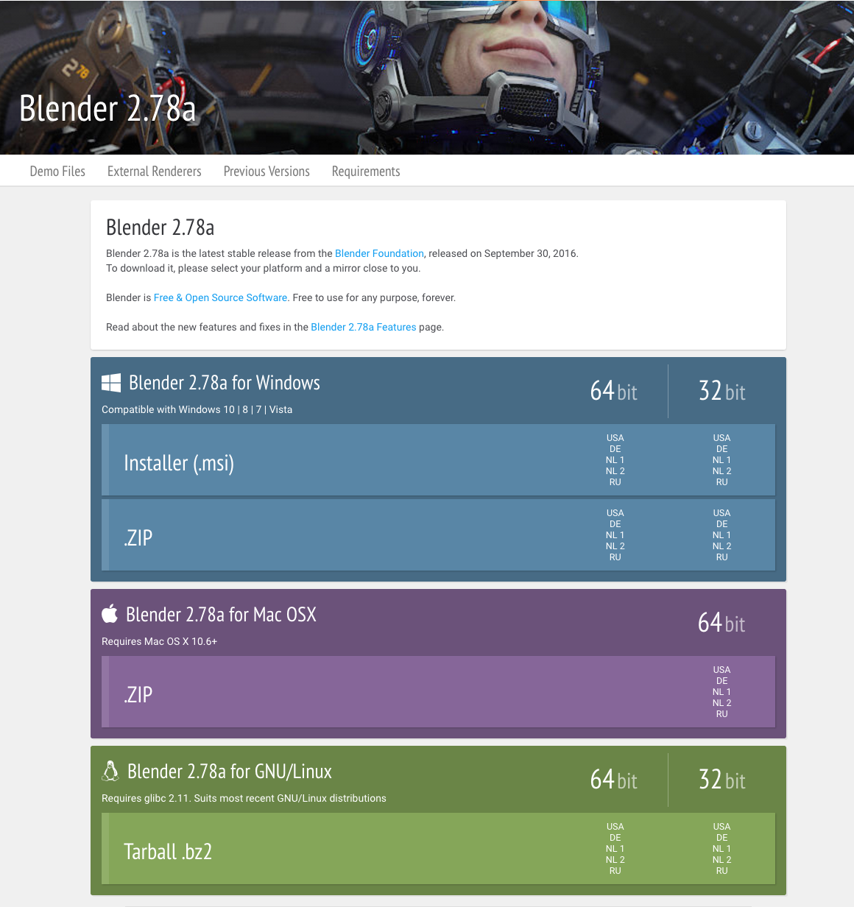
First - time User Experience for Blender
Experiencing Blender Website
Avoiding Signing Up
Navigator Bar
Color Contents
Experiencing Blender Application
Tutorials Provided in Blender
Blender Usability Environment

Slide 4
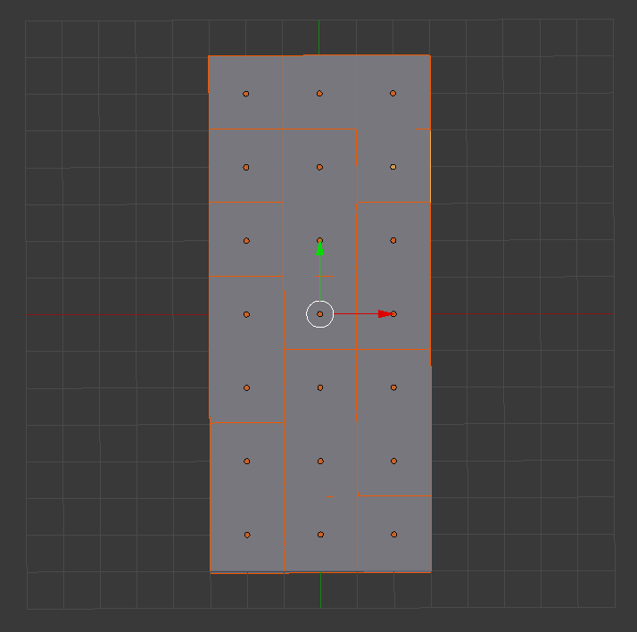
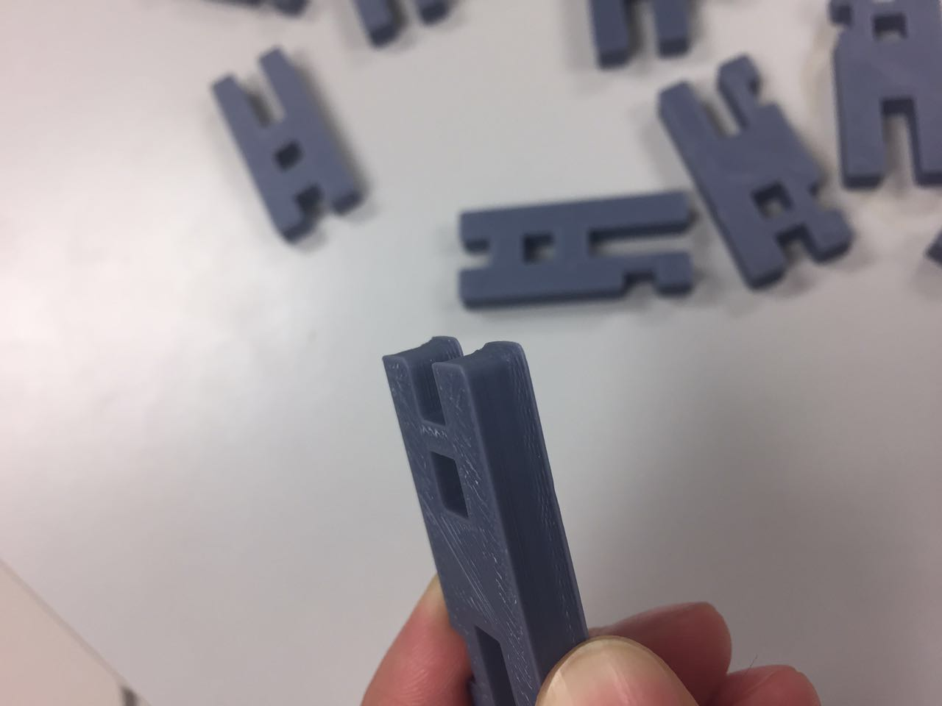
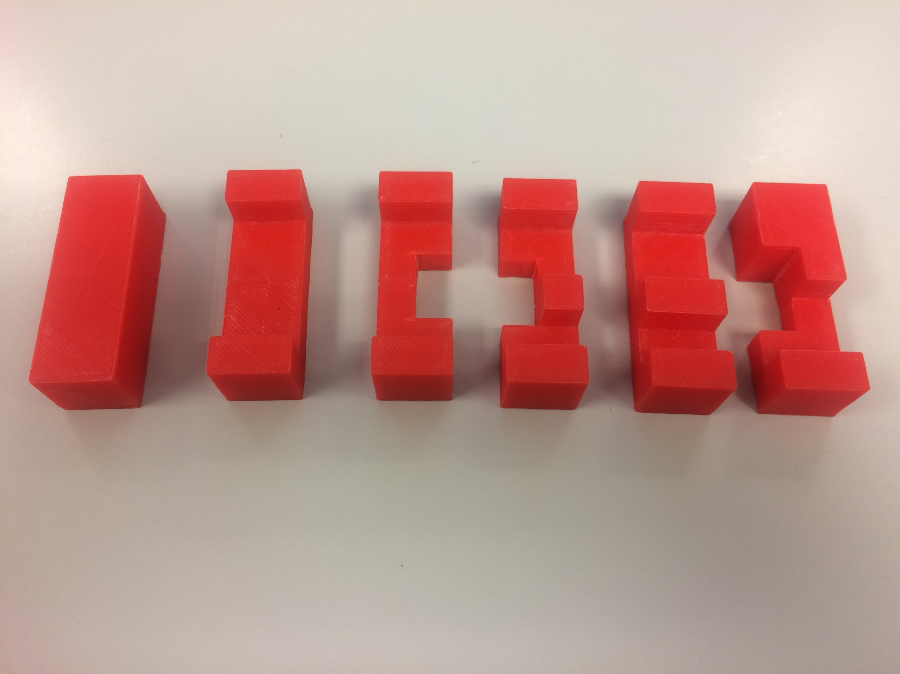
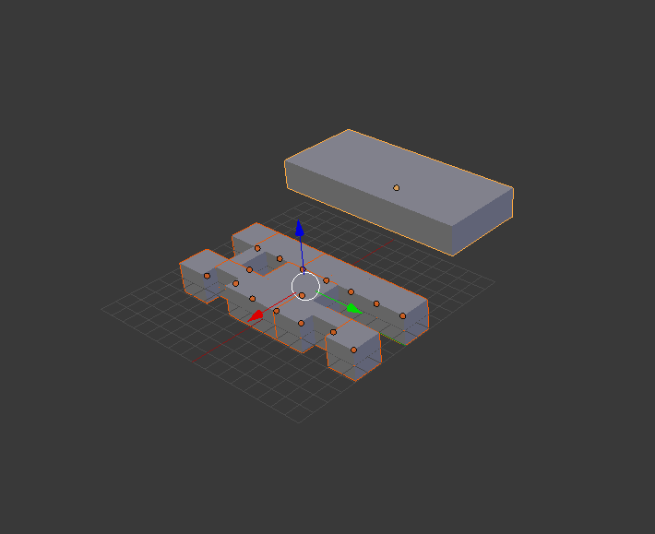
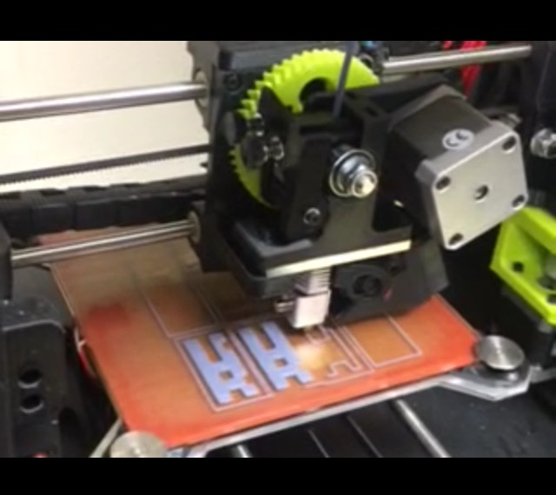
Model Constructing
The First Model
The Second Model
Analysis of our Method
3D Printing

Slide 5
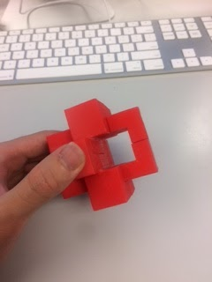
Burr Puzzle Evaluation
Taking Apart
Reassembling
All similar
Hard to image 3d in mind

Slide 6
Conclusion
Blender - Strong Modeling Application
3D Printing - Successfully Build Up the Puzzle
Burr Puzzle - Creative Design

